Slide 1
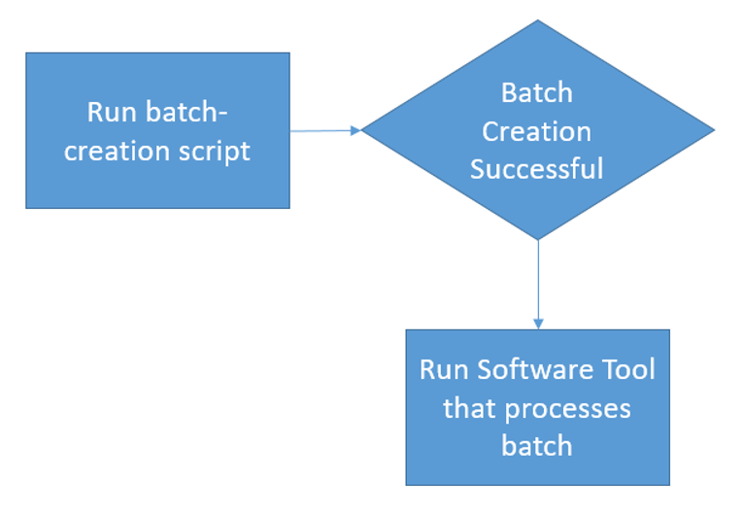
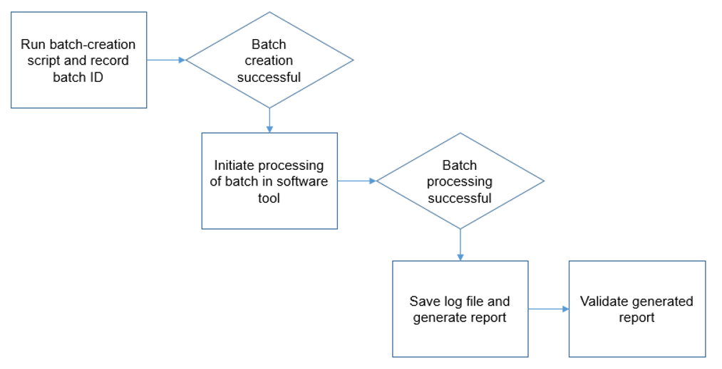
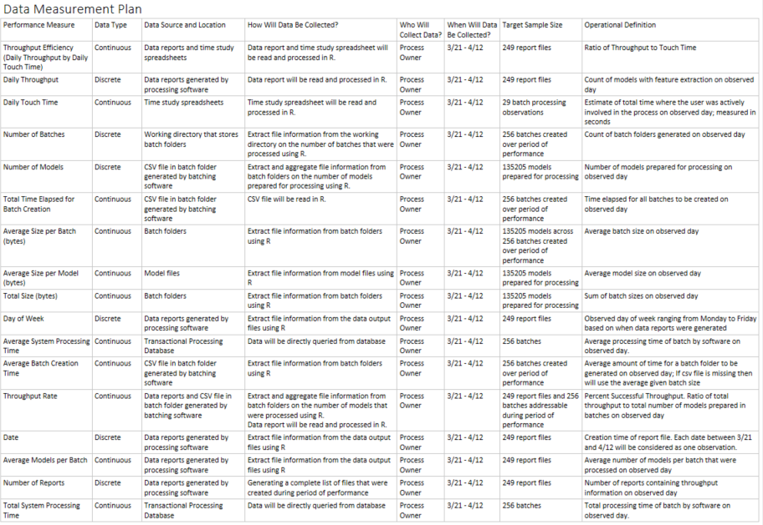
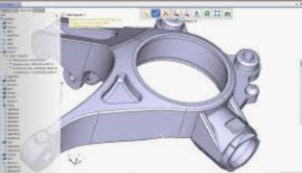


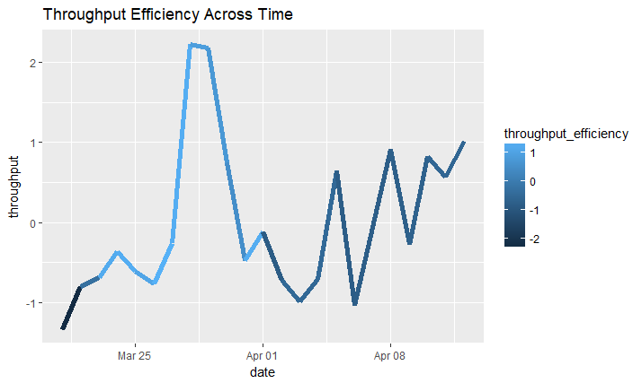
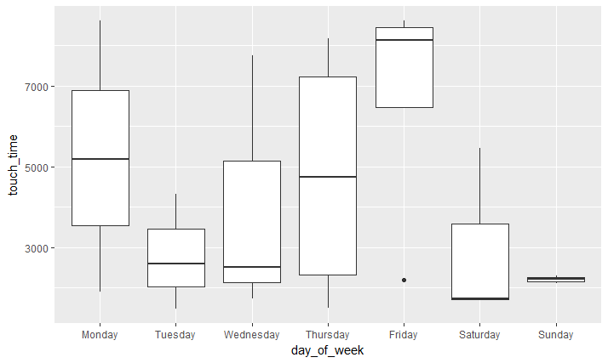

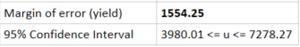
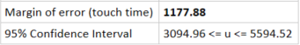


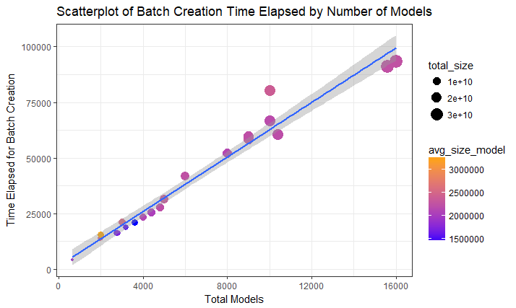
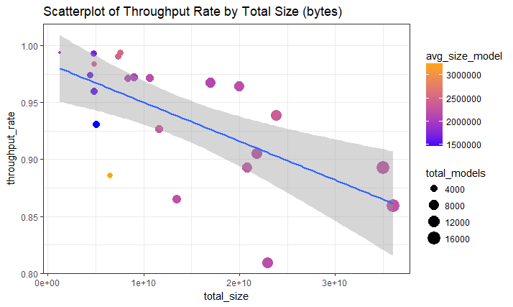
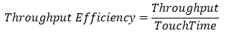
MBC 638
Geometry Feature Extraction Efficiency
Process owner: Thomas Bahng
Key Dates --->
Team Launch
April 8
Define
April 12
Measure
April 19
Analyze
May 17
Improve
May 24
Control
June 7
DEFINE
MEASURE
ANALYZE
IMPROVE
In 3 weeks, $2,500 of overhead labor will go towards a process to extract data from CAD models for downstream machine-learning apps.
Highly skilled engineers will spend 25 hours performing low-skill tasks in order to reach yield objectives.
Due to an inefficient process, other complex projects are impacted by capacity constraints.
Collected 22 daily observations of 17 variables from logs, time studies and Excel reports.
Too many touch-points in the end-to-end process.
Software Optimization
Parallel processing
Leverage 3rd party API
Increase batch size
Reduce touch-points
1988% increase in throughput efficiency
Can touch-times be reduced such that the same yield can be accomplished with less user involvement?
47,600
Defects per Million Opportunities
Sigma Quality Level
3.15
135,000 CAD models were processed during the performance period. Average daily yield (# models) and touch-times (seconds) exhibit a high margin of error.
High Variability
CONTROL
x̅̄ = 5629
Can software performance and backend integration be optimized to increase yield over time?
Accessibility to technical documentation
Shareable / Executable / Compatible Software
Low risk / Minimal commitment required to sustain activity by a single user.
Monitor Trends in future use cases.
x̅̄ = 4344
545,500
Defects per Million Opportunities
Sigma Quality Level
1.35
$$Throughput Efficiency=\frac{Throughput}{TouchTime}$$
TEAM MEMBERS
Thomas, Systems Engineer, Product Manager, Stakeholders

Slide 2
MBC 638
Geometry Feature Extraction Efficiency
Define
Process owner: Thomas Bahng
Problem Statement
A process exists to generate feature extraction reports for data collection to support downstream machine-learning applications. This process extracts features from CAD models using a software tool and requires manual input by engineers to facilitate the process. The engineer's time is limited to a standard 8-hour workday, per union regulations, and this project seeks to minimize touch-time whilst achieving the minimum throughput objective of 5,000 models per day.
Models are processed in batches. Batches can vary in the number of models and can be controlled in this experiment. The above target is based on a batch size of 1,000 models (i.e. 5 batches per day).
Pain points made evident by feedback from the team and fluctuating daily throughput:
Individuals have to constantly manage the process.
Process needs structuring to allow for more focus on other work.
Lack of progress, both in this activity and other work, due to capacity constraints.
Daily throughput is inconsistent and as a result weekly targets are not always met.
Business Impact
The engineer should be spending the majority of their daily time on more complex work statements rather than this activity.
This experiment will use a labor rate of $100 per hour. Touch-time per batch has been measured at 456 seconds (7.6 minutes). Based on this information, the engineer spends 2% of their daily time on a single batch ($16). At the target rate specified for daily throughput, the cost is approximately $80 per day.
Over a typical 3 week period of performance, upwards of $2,500 of overhead labor and 25 hours can be directed to this process alone.

Slide 3
MBC 638
Geometry Feature Extraction Efficiency
Define
Process owner: Thomas Bahng
Goal
The goal of the project is to achieve throughput objectives specified for a period of performance and minimize manual touch-time.
The response variable for measuring success is throughput efficiency, the ratio of daily throughput to total engineer touch-time. Daily throughput is measured by models processed per day. Total engineer touch-time is measured in seconds of time spent actively involved in the process shown below.
Success will be measured by a 10% increase in the response variable while maintaining or exceeding the target rate of 5,000 models processed per day.
Baseline:
Average daily throughput efficiency: 1.34 models / second of touch-time
Standard deviation of daily throughput efficiency: 0.4
Target: Average daily throughput efficiency of at least 1.34 * 1.1 = 1.47 models / second of touch-time
End-to-End Process Map (for a single batch)
Run batch-creation script and record batch ID (123.16 s).
If a batch is successfully created, initiate processing of batch in software tool (125.88 s).
Save log file and generate report (193.05 s).
Validate generated report (14.18 s).
Business Process Period of Performance
Start baseline data collection
3/21
Start improve data collection
5/10 (deploy)
Define
Measure
Analyze
Improve
Control
March
April
May
June
End baseline data collection
4/12
End improve data collection
5/30

Slide 4
MBC 638
Geometry Feature Extraction Efficiency
Define
Process owner: Thomas Bahng
Sigma Quality Level
A defect is defined as:
Not meeting the customer requirement for processing a minimum of 5,000 models per day (i.e. throughput >= 5,000).
There are unprocessed batches at the end of the day (i.e. total batches > total number of batch reports).
There are two defect opportunities per unit (per observed day).
Data was collected over a period of 22 days. For each day, the total number of model batches, output reports, and throughput were measured.
Is the Process in Control?
Baseline
Variable | Value
Defect Opportunities per Unit | 2
Total Units (# of days) | 22
Total Possible Defects | 44
Total Actual Defects | 24
Defects per Opportunity Rate | 0.5455
Defects per Million Opportunities | 545500
SQL | 1.35
Displaying Throughput Efficiency
(Individual Moving Range)
We do not have a stable, controlled process. The upper control limit is exceeded in multiple observations for both the moving range and individual chart. The measurement system also appears to be in need of improvement. This means that this system could be at risk of not offering repeatable measurements. Given the high degree of variability in the process as displayed per the storyboard, the exceeding of these upper limits are quite possibly due to larger touch-times to push more models through the process in order to make up for lost productivity.
Over the range of 22 observed days, the Sigma Quality Level of the baseline process was calculated to be 1.35.

Slide 5
MBC 638
Geometry Feature Extraction Efficiency
Measure
Process owner: Thomas Bahng

Slide 6
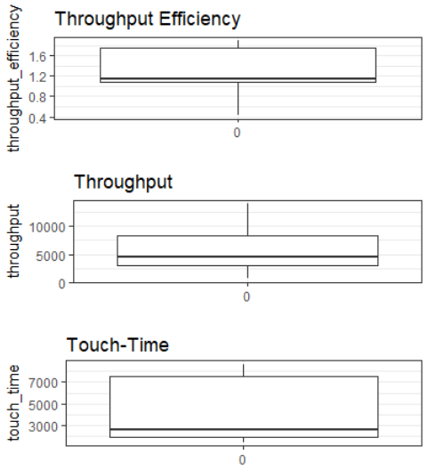
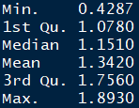
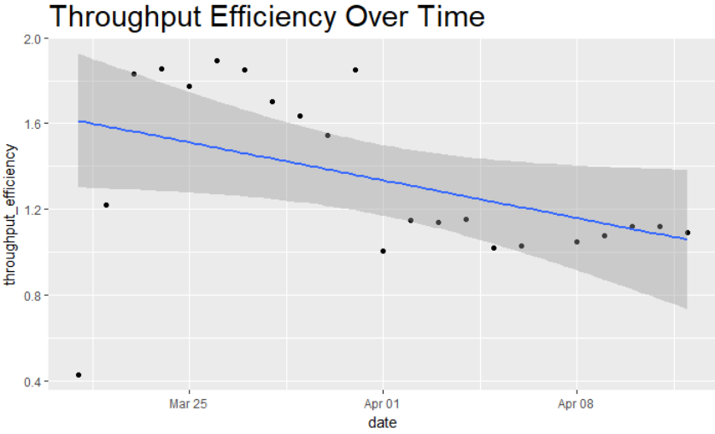
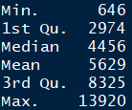
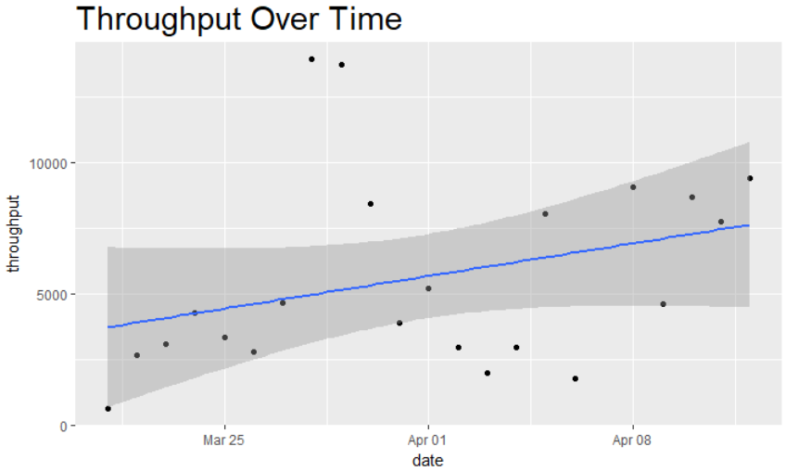
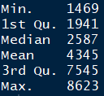
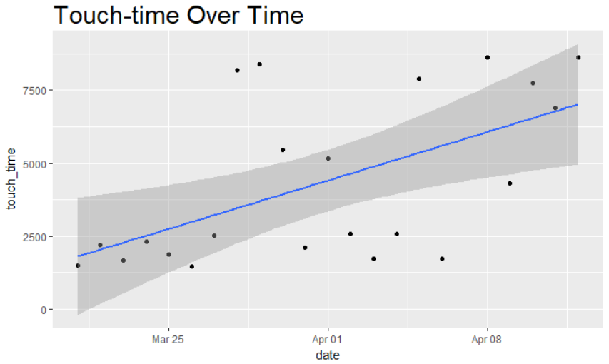
MBC 638
Geometry Feature Extraction Efficiency
Measure
Process owner: Thomas Bahng
Distribution and Trend of Our Response Variable
We see a steady decrease in efficiency over time with some moderately unusual values in the lower range. Most of the data resides above the rate of 1 model / second of touch-time.
Throughput and Touch-time display greater variability over time. The distribution and wide interquartile range for touch-time indicate the greatest area of opportunity for improvement.
Key Operational Definitions:
Daily Throughput is measured by counting the number of models with feature extraction on any given day during the period of performance. The output from feature extraction is contained in the excel reports generated by the software tool.
Daily Touch-time, measured in seconds, is an average estimated amount of time where the user was actively involved in the process. See touch-points on the previous process map. Time-studies are conducted to calculate the average estimated time for each touch-point in the process.
Throughput Efficiency is the ratio of Daily Throughput to Daily Touch-time. It is measured as the number of models per second of touch-time.

Slide 7
MBC 638
Geometry Feature Extraction Efficiency
Measure
Process owner: Thomas Bahng
Data Collection
Data collection for the baseline process was made possible by a repository of csv log files, batch folders that were processed, excel reports generated by the processing tool, and SQL access to a transaction database.
The data from these multiple sources were aggregated into a table of daily observations.
The total compressed size of the baseline data was about 50MB, which took several hours to generate via an automated program script. This was mainly due to the extraction of file information from 135,000+ CAD model files of varying size and complexity. The purpose was to include as many variables that might potentially influence the components of the response variable, daily throughput and touch-time.
Measurement Error
Missing Files
Approximately 4% of batches were missing information needed to assess model size (in bytes). For these batches I had to get file sizes for different versions of the same models to determine an estimate. The error is not expected to be large as there are business requirements keeping a models form, fit, and function intact throughout its version history.
80% of batches were missing information on time elapsed for batch creation. This was addressed by taking the mean time elapsed given the discrete number of models in a batch and applying across observations with missing values. This impact will be furthered explored in the data analysis.
Time-Study
There were limited resources to perform a robust time-study, therefore only 29 touch-time observations were recorded. Mean touch-time per batch size level was extrapolated across all processed batches.
At best, touch-times measured will be an approximation given the batch size level, and not an exact measure.
System Issues
Approximately 2% of batches were missing system processing times by the feature extraction software. I took a similar approach as before by averaging system processing time by number of models for batches missing system processing time. The risk is that some models may be larger in size thereby skewing this metric due the sensitivity of the mean to extreme values. However, due to the small number affected batches, and by measuring a fairly large sample of 256 batches, I believe this issue to be mitigated to an extent.

Slide 8
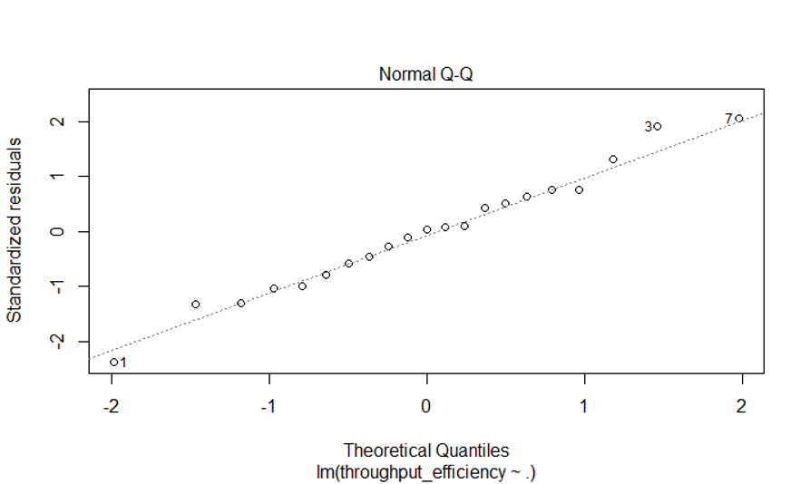
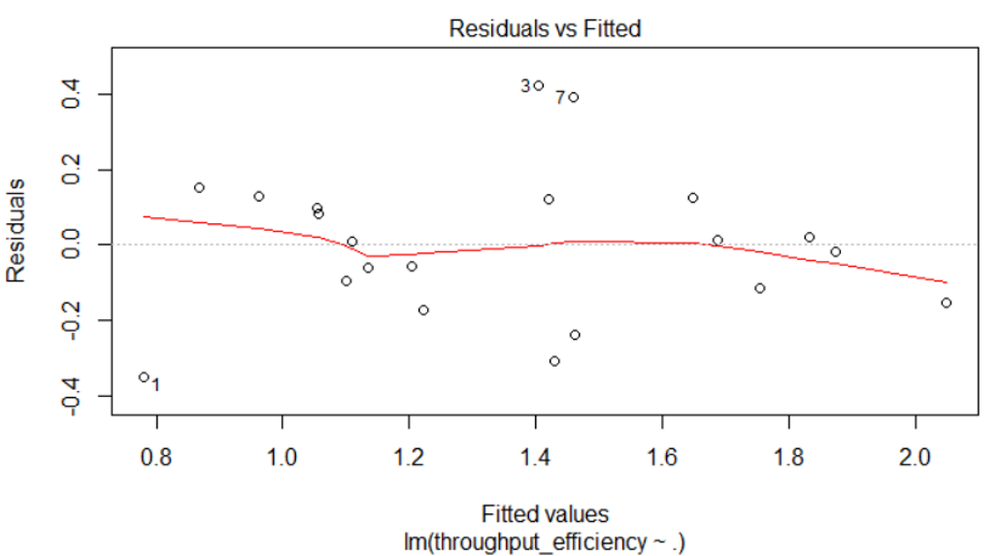
MBC 638
Geometry Feature Extraction Efficiency
Analyze
Process owner: Thomas Bahng
Correlation Matrix of Measured Variables and Understanding Their Relationship
It appears that there is very weak correlation between all predictor variables to the response variable "Throughput Efficiency". Given this insight, I performed separate multiple regressions on the components of the response variable (i.e. Throughput and Touch-time).
Regression: "Throughput Efficiency" ~ Predictor Variables
After 9 iterations of backwards stepwise regression and removing insignificant predictors, the resulting model did not give much insight into predictors with a substantial effect size towards the response variable.
Y = 0.005(X_{avg_models_batch}) + 0.00006(X_{total_time_batching}) - 0.0005(X_{avg_time_batching}) - 0.0000000003(X_{total_size}) + 0.1(X_{total_reports}) + 0.00002(X_{total_sys_time_processing}) - 0.00004(X_{avg_sys_time_processing}) + 0.00000000009(X_{avg_size_batch}) + 0.8(X_{is_sundayTRUE}) - 0.3
p-value of regression: 0.01933
Adjusted R2: 0.5632

Slide 9
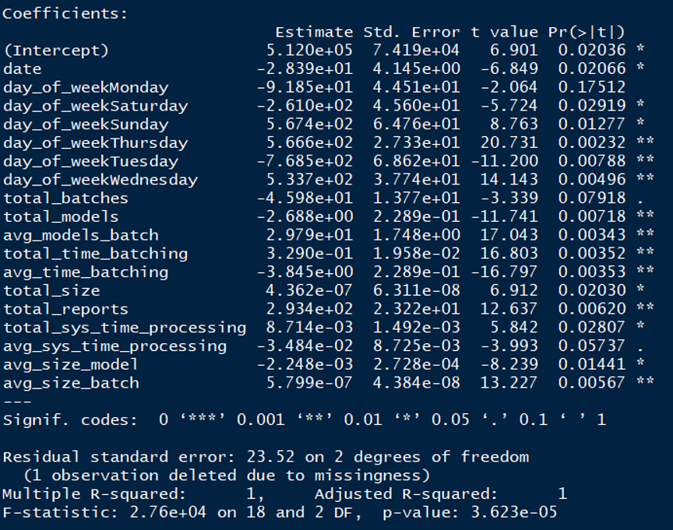
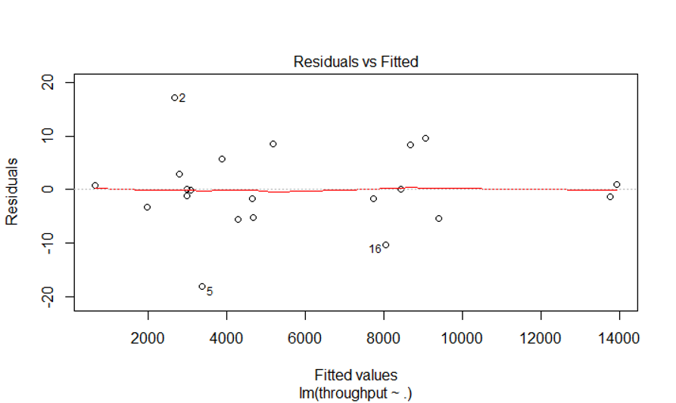
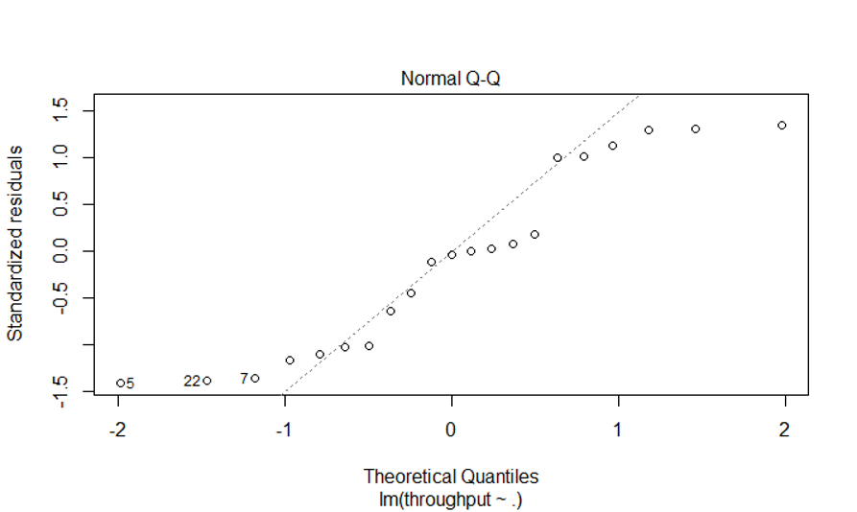
MBC 638
Geometry Feature Extraction Efficiency
Analyze
Process owner: Thomas Bahng
Regression Continued
"Throughput" ~ Predictor Variables
After only 1 iteration the model already appears quite useful and informative, despite its complexity.
The most significant variable that's not a day of the week is the Average Number of Models per batch. This variable and other related significant variables appear to state that there's opportunity to improve the current process by systematically increasing the number of models pushed through in each batch. The current batch size holds 1,000 models. This model also gives us insight into the negative effects on Throughput by certain variables such as the Average Time for Batch Creation and the Total Number of Models. The greater the number of models that are input into the system, the greater the number of models that might encounter throughput issues due to various reasons (e.g. bad model integrity, insufficient memory).

Slide 10
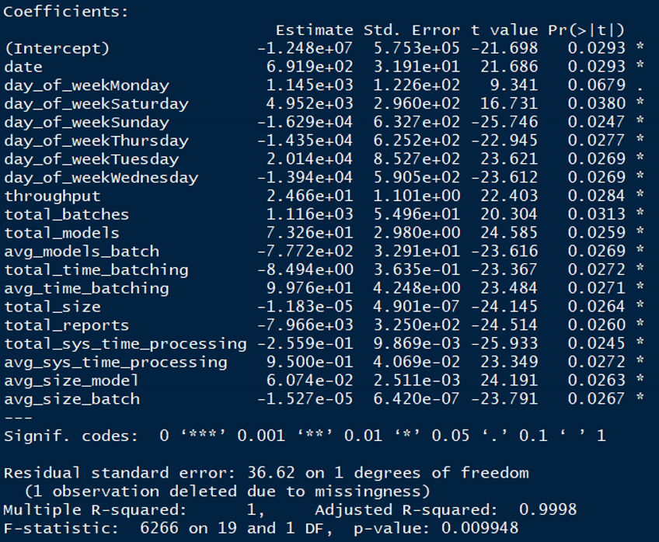
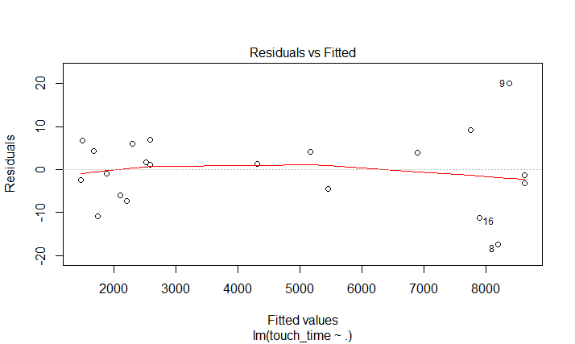
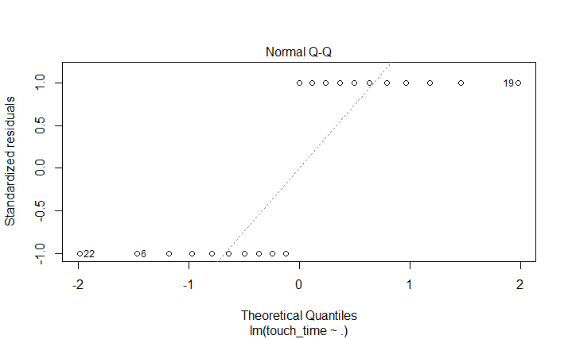
MBC 638
Geometry Feature Extraction Efficiency
Analyze
Process owner: Thomas Bahng
Regression Continued
“Touch-Time" ~ Predictor Variables
After only 1 iteration the model already appears quite useful and informative, despite its complexity.
Variables of interest are those with the greatest effect size. Total Number of Reports generated has a very strong negative effect on Touch-Time. This was contradictory to expectations because each report requires a certain amount of touch-time to generate. This could be due to other confounding variables or perhaps measurement error on the part of the time-studies conducted and extrapolation based on limited information. The aim of the process improvement is to reduce the Touch-Time thereby increasing Throughput Efficiency. Perhaps if we looked at this effect as an "capability to generate more reports", such as through automation, then this could be seen as a huge opportunity for improvement on lowering Touch-Time.

Slide 11
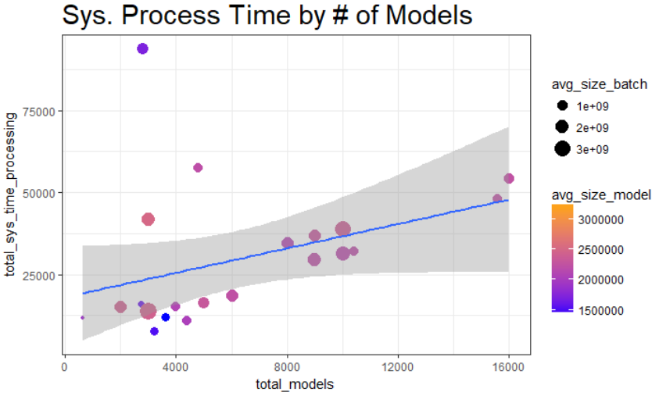
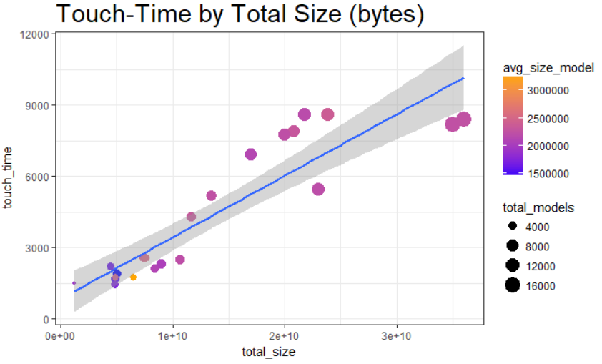
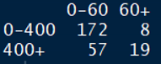
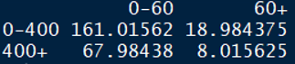
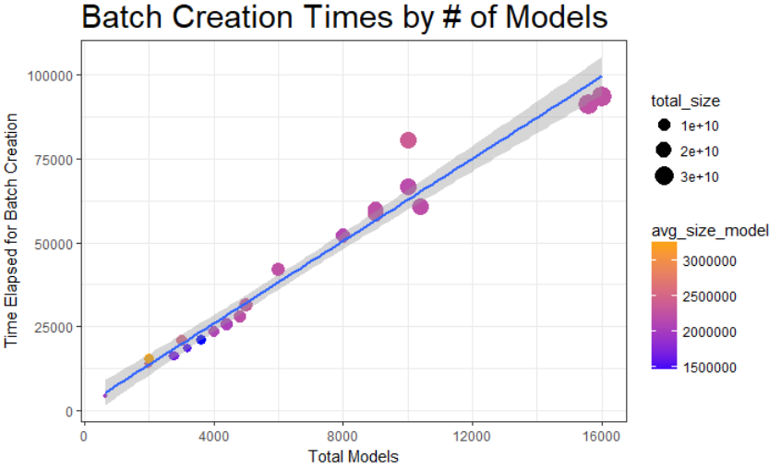
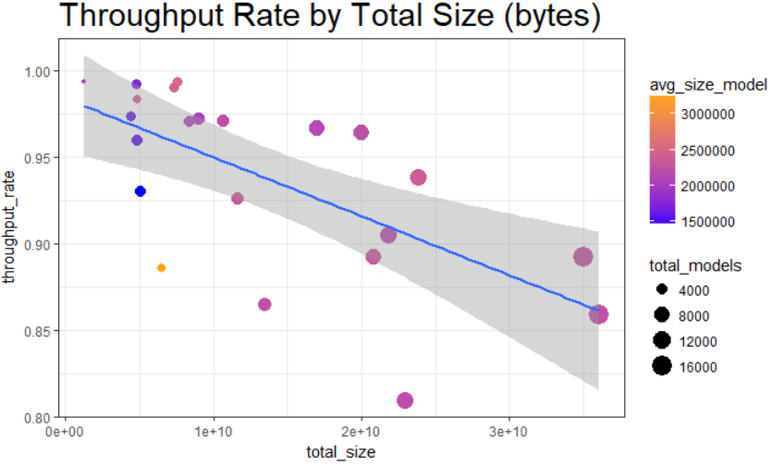
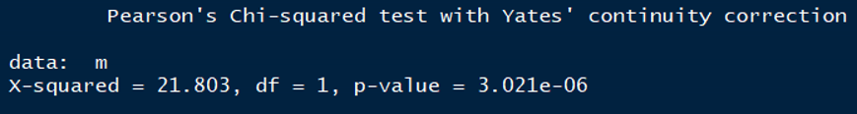
MBC 638
Geometry Feature Extraction Efficiency
Analyze
Process owner: Thomas Bahng
Understanding the System (software) Inputs
Chi-Squared Test for Independence
Is there a relationship between batch size and system processing time?
Observed and Expected two-way tables
batch size (i.e. 0-400 models | 400+ models) in rows and system processing time (i.e. 0-60 minutes | 60+ minutes) across columns.
Hypothesis
H₀: Batch Size and System Processing Time are independent
H_{a}: Batch Size and System Processing Time are not independent
Conclusion: Reject the null hypothesis because the two variables are not independent.
Scatterplots
A significantly positive relationship exists between system processing times, the number of models, and their sizes.
Touch-time also correlates positively with the same variables that put strain on the system.
System performance is prone to some wide variations (outliers) given factors outside the measurements of the process.
Although daily throughput increases as you process more models, the rate at which it generates useful data (i.e. throughput rate) decreases as the size and number of models increase, which may require rework in the future.

Slide 12
MBC 638
Geometry Feature Extraction Efficiency
Analyze
Process owner: Thomas Bahng
Confidence Intervals of the True Means for the Baseline Process
Average daily throughput with 95% confidence is between 3980.01 and 7278.27 models
Variable | Value
Level of significance (alpha) | 0.05
t-value | 2.08
Degrees of freedom | 21
Sample Size | 22
Sample Mean | 5629.14
Sample Standard deviation | 3719.49
Margin of error | 1554.25
Lower Bound | 3980.01
Upper Bound | 7278.27
Average daily touch-time with 95% confidence is between 3094.96s and 5594.52s
Variable | Value
Level of significance (alpha) | 0.05
t-value | 2.08
Degrees of freedom | 21
Sample Size | 22
Sample Mean | 4344.74
Sample Standard deviation | 2818.79
Margin of error | 1177.88
Lower Bound | 3094.96
Upper Bound | 5594.52
Average daily throughput efficiency with 95% confidence is between 1.16 and 1.52 models/s
Variable | Value
Level of significance (alpha) | 0.05
t-value | 2.08
Degrees of freedom | 21
Sample Size | 22
Sample Mean | 1.34
Sample Standard deviation | 0.4
Margin of error | 0.17
Lower Bound | 1.16
Upper Bound | 1.52
The components of throughput efficiency are throughput and touch-time.
Note the very large standard deviation and margin of error ( > 60% of the mean)
It is hard to get an accurate picture of the mean with such a wide margin of error at the 95% confidence level
Unless we either increase the sample size or if we can find a way to decrease the standard deviation
This large margin of error exhibits a high risk that the current process is subject to defects.
Ideal Sample Size
We can estimate the population mean for the response variable to within 0.17 units with 95% confidence.
The baseline margin of error was calculated using an alpha level of 0.05, a sample size of 22 observations, and a standard deviation of 0.4 throughput units per second of touch-time.
If we wanted to decrease the margin of error by 10% after improvements are made to the process, then we would require an ideal sample size of 28 observations (days) while maintaining the 95% confidence level and baseline standard deviation of 0.4.
The risk of collecting fewer samples may result in a margin of error the same or greater than that observed for the baseline sample and lower the accuracy of the confidence interval for the true mean that is inferred after a process improvement has been implemented.
Ideal Sample Size with 10% decrease in margin of error
Variable | Value
Standard Deviation | 0.4
z-score | 1.96
Margin of error | 0.17
Desired Margin of error | 0.15
Ideal Sample Size | 27.16

Slide 13
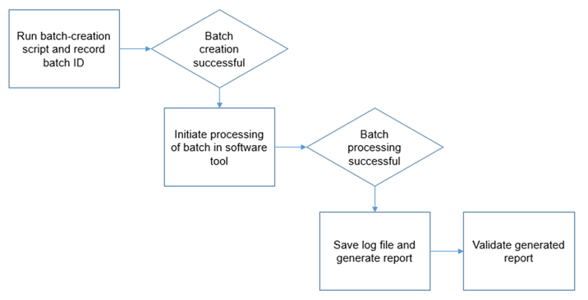
MBC 638
Geometry Feature Extraction Efficiency
Improve
Process owner: Thomas Bahng
Insights from the regression analysis helped to key in on predictor variables such as Average Number of Models per batch, Average Time for Batch Creation, Total Number of Models, and Total Number of Reports. By understanding how these variables influenced (Y), a new process was deployed on 5/10 that:
Enhanced tool capability
Parallelized the batch creation process across multiple processing cores on each computer running the script.
Employed the use of new software for further automation of the feature extraction process.
Increased the potential throughput parameter to 2600 models per batch from the original baseline of 1000 models.
Eliminated touch-points in the process
Reduced the number of engineer touch-points in the end-to-end process by half.
Old Process
New Process
Improvement Opportunity to leverage software tool’s API so that user doesn’t have to perform this step for each batch.
Faster creation of larger batches
Improvement Opportunity to eliminate completely given enhanced tool capability
New software tool will automatically process multiple batches using API
Total end-to-end touch-time (Old Process) was 456.3 seconds
Total end-to-end touch-time (New Process) is 93.4 seconds
As a result, average end-to-end batch processing touch-time was reduced by 80%.

Slide 14
MBC 638
Geometry Feature Extraction Efficiency
Improve
Process owner: Thomas Bahng
Confidence Intervals of the True Means for the Improved Process
Improved
Sample
Statistics
Throughput
3% increase in average throughput | 62% decrease in standard deviation | 61% decrease in the margin of error.
Touch-time
95% decrease in average touch-time | 98% decrease in standard deviation | 98% decrease in margin of error.
Throughput Efficiency
1988% increase in average throughput efficiency
Hypothesis Test
Continuous Two Sample Left-tailed test
Hypothesis Statement: H₀: u1 >= 27.98 | H_{a}: u1 < 27.98
Rejection Rule: If p value is <= 0.05 then reject the null hypothesis.
Result
p-value is practically zero and less than alpha.
Reject null hypothesis due to sufficient evidence at level of significance alpha = 0.05
Throughput Efficiency has significantly improved.

Slide 15
MBC 638
Geometry Feature Extraction Efficiency
Improve
Process owner: Thomas Bahng
Sigma Quality Level
A defect is defined as:
Not meeting the customer requirement for processing a minimum of 5,000 models per day (i.e. throughput >= 5,000).
There are unprocessed batches at the end of the day (i.e. total batches > total number of batch reports).
There are two defect opportunities per unit (per observed day).
Data was collected over a period of 21 days. For each day, the total number of model batches, output reports, and throughput were measured.
Is the Process in Control?
Baseline
Variable | Value
Defect Opportunities per Unit | 2
Total Units (# of days) | 21
Total Possible Defects | 42
Total Actual Defects | 2
Defects per Opportunity Rate | 0.0476
Defects per Million Opportunities | 47600
SQL | 3.15
Displaying Throughput Efficiency
(Individual Moving Range)
We seem to have a stable, controlled process. The upper control and lower control limits are not exceeded in any instances with the exception of the start of the period of performance.
Over the range of 21 observed days, the Sigma Quality Level of the improved process was calculated to be 3.15.
This score indicates that the new process gives out higher quality output in meeting customer requirements with fewer defects and inefficiencies.

Slide 16
MBC 638
Geometry Feature Extraction Efficiency
Improve
Process owner: Thomas Bahng
Summary: Improve
“Success will be measured by a 10% increase in the response variable while maintaining or exceeding the target rate of 5,000 models processed per day”
In the new process, the response variable (throughput efficiency) increased by 1988%.
Daily targets were met in most cases and the number of actual defects decreased as shown by the new Sigma Quality Level.
The process was improved to such an extent that only 1 engineer was needed to accomplish this activity in the specified period of performance.
The process was improved and statistically validated through a two-sample left-tailed hypothesis test.
The Sigma Quality Level of the new process increased to 3.15 from 1.35.
Process Control Charts display a more stable and controlled process with common cause variation driven largely by noise.
Lessons Learned
Program subroutines could be further optimized to accomplish more in less time. There were too many touch-points in the old end-to-end process, which when multiplied over the number of required batches, resulted in a great deal of touch-time per day. Data manipulation and validation by users was separated out from the process entirely and automated. Software could be developed to leverage available APIs and automate multiple iterations of batch processing. As a result, more models could be processed through the end-to-end pipeline with minimal touch-time.

Slide 17
MBC 638
Geometry Feature Extraction Efficiency
Control
Process owner: Thomas Bahng
Time-Series of Throughput Efficiency in the New Process
Exponential Smoothing time series of the business process period of performance from 5/10 - 5/30.
This activity is not prone to seasonal variation, therefore exponential smoothing was used to display a time series of the improved process. Overall we get a very smooth trend of a stable and consistent process.
There isn’t a need to use exponential smoothing for forecasting future values, but it is useful for identifying changes in trend. This tool, along with the control charts shown earlier, will alert stakeholders of signals and patterns that may arise from this process in future use-cases.
Conclusion & Next Steps
Over the course of this project, over 200,000 models were run through a baseline and improved process.
The improvements deployed were statistically validated to be a success, and the new process is proving to be doing more with less touch-time. This accomplishment will support the overall technical readiness level milestones of the team and enable us to generate more value for the company.
As this process continues, we are sure to get better confidence intervals of our throughput capability as we continue to grow our sample size and reduce the margin of error.
In the next activity sprint, the new process will be put to the test again. We may encounter operating under different system environments, different types of models, and new users. However steps were implemented to ensure sustainability:
Process instructions were formally documented and made available to the team. This included accessible software requirements and dependencies.
Open source software was packaged to be shared and executable by internal team.
This process can now be sustained by a single engineer, taking up only 4 minutes of actual touch-time per day. Risk and impact on other projects are significantly mitigated by the minimal commitment needed throughout the entire period of performance (i.e. 1.4 hours of total touch-time vs 25 hours).

